Slide 1
Ethics in Science and Scientific Research

Slide 2
Other Cases
Robert Gallo vs. Luc Montaigner.
Thereza Imanishi-Kari.
Trofim Lysenko’s Science.
The Cold Fusion Case.
Manhattan Project.
Hiring von Braun – Operation Paper Clip.
Vaccination Hoax in Pakistan.
Using Psychologists for Enhanced Interrogation in Guantanamo.

Slide 3
List of Fake/Fraudulent Journals
http://fake-indian-journals.blogspot.pt/2015/03/complete-list-of-fake-predatory-or.html#!/2015/03/complete-list-of-fake-predatory-or.html

Slide 4
Central Topics (1)
Ethical Behavior in Universities, Institutes, Research Centres.
Facts vs. Values.
Value Free? Axiological Neutrality? Topic Choice?
Beliefs, Lucidity, and Credibility.
Independency and Transparency.
Authorship and Its Myths.
Collaboration and Equity.
Authority, Expertise, Contributions.

Slide 5
Central Topics (2)
Plagiarism, Fraud.
Independence. The Presence of Disclaimers.
Subsidizing What?
Trends, Fads, and Fashions.
Exclusion and Inclusion.
Definition of Rights.
Designing Experiments.
Data Sharing and the Logic of the Commons.

Slide 6
Central Topics (3)
Publish or Perish – Ethical and Effectiveness.
Science-Technology and Ethics.
Conflicts of Interest.
Frankenstein and Disgust – The Limits of Science. The Wisdom of Repugnance.
New Deontological Codes.
Using Stolen Data.
Searching the Truth.

Slide 7
Central Topics (4)
Faking and Falsifying.
Medicine and Sports.
Due Credit.
Referees, Editors and Organizers.
Precautionary Science – the Sins of Pride.
Censorship Problems.
Misconduct.
Consent.

Slide 8
Central Topics (5)
Deception.
Validity and Evidence.
Mentoring, Coaching and Supervision.
Duties, Responsibility and Integrity.
Online Research.
Patents and Copyrights.
Chronocentric and Ethnocentric Biases.
Exporting Skeletons.

Slide 9
Some References

Slide 10
The Price of Truth
1. Science and Mammon
2. The Norms of Science
3. Scientific Objectivity
4. Money and the Norms of Science
5. Conflicts of Interest: When Is Disclosure Not Enough?
6. Intellectual Property: Balancing Public and Private Interests
7. Publication: Openness and Accountability
8. Government Funding of R&D: Science as a Public Good
9. Conclusion: Valuing Truth and Integrity in Research

Slide 11
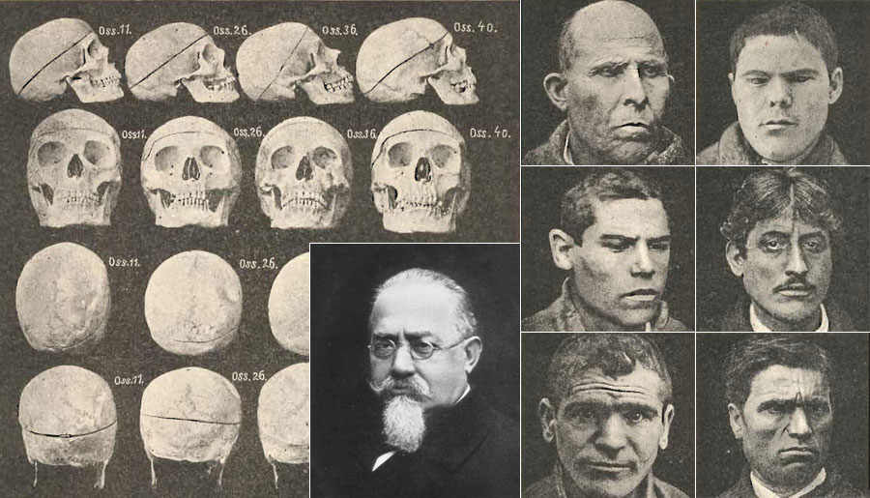
Lombroso’s Research

Slide 12
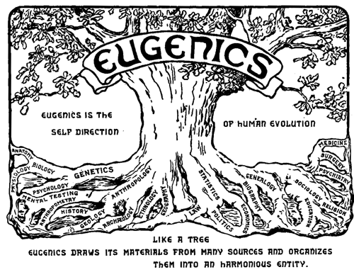
Eugenics

Slide 13
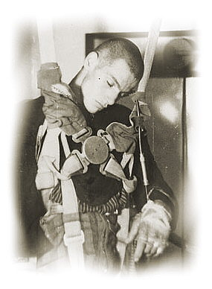
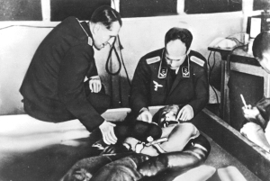
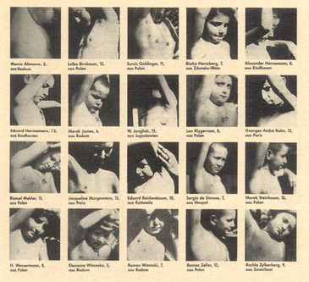
Mengele’s Experiments

Slide 14
The Tuskegee Study of Untreated Syphilis
The Tuskegee Study of Untreated Syphilis in the Negro Male, also known as the Tuskegee Syphilis Study or Tuskegee Syphilis Experiment was an infamous clinical study conducted between 1932 and 1972 by the U.S. Public Health Service studying the natural progression of untreated syphilis in rural African-American men in Alabama under the guise of receiving free health care from the United States government. The 40-year study was controversial for reasons related to ethical standards because researchers knowingly failed to treat patients appropriately after the 1940s validation of penicillin as an effective cure for the disease they were studying. Revelation in 1972 of study failures by a whistleblower led to major changes in U.S. law and regulation on the protection of participants in clinical studies. Now studies require informed consent, communication of diagnosis, and accurate reporting of test results

Slide 15
Egas Moniz
Prefrontal Leukotomy
Cerebral surgery had been tried in a few psychiatric cases as early as 1891 and 1910, particularly patients with manic-depressive psychosis. These trials did not attract much attention, but at a neurology conference in London in 1935, at which the Portuguese neurologist Egas Moniz participated, Jacobsen & Fulton presented data from operations on two chimpanzees which, after a leukotomy, managed to make mistakes without becoming aggressive, something which they had not managed to do before. Many people have considered this information to have instigated Moniz's "bold step" in November 1935. In 1936 Moniz published his first report on prefrontal leukotomy. One reason why Moniz's operations gained better acceptance than the earlier trials mentioned above was evidently the fact that he was internationally respected for having developed cerebral angiography. Moniz's first twenty cases all survived and did not develop any serious morbidity. The leukotomy soon achieved a good reputation in, among other countries, Brazil, Italy and the United States. Moniz strongly believed that the potential benefits of surgical lesions in the frontal lobes, even allowing for some behavioral and personality deterioration, outweighed the debilitating effects of severe psychiatric illness.

Slide 16
Korean Cloning Fraud
Hwang Woo-suk is a South Korean veterinarian and researcher. He was a professor of theriogenology and biotechnology at Seoul National University (dismissed on March 20, 2006) who became infamous for fabricating a series of experiments, which appeared in high-profile journals, in the field of stem cell research. Until November 2005, he was considered one of the pioneering experts in the field, best known for two articles published in the journal Science in 2004 and 2005 where he reported he had succeeded in creating human embryonic stem cells by cloning. He was called the "Pride of Korea" in South Korea. Soon after the first paper was released, however, an article in the journal Nature charged Hwang with having committed ethical violations by using eggs from his graduate students and from the black market.Although he denied the charges at first, Hwang admitted the allegations were true in November 2005. Shortly after that his human cloning experiments were revealed to be fraudulent. On May 12, 2006, Hwang was charged with embezzlement and bioethics law violations after it emerged much of his stem cell research had been faked. The Korea Times reported on June 10, 2007, that Seoul National University fired him, and the South Korean government canceled his financial support and barred him from engaging in stem cell research. While being charged with fraud and embezzlement, he has kept a relatively low profile at the Sooam Bioengineering Research Institute in Yongin, Gyeonggi Province, where he currently leads research efforts on creating cloned pig embryos and using them to make embryonic stem-cell lines.

Slide 17
The Sokal Hoax
The Sokal affair, also called the Sokal hoax, was a publishing hoax perpetrated by Alan Sokal, a physics professor at New York University and University College London. In 1996, Sokal submitted an article to Social Text, an academic journal of postmodern cultural studies. The submission was an experiment to test the journal's intellectual rigor and, specifically, to investigate whether "a leading North American journal of cultural studies – whose editorial collective includes such luminaries as Fredric Jameson and Andrew Ross – [would] publish an article liberally salted with nonsense if (a) it sounded good and (b) it flattered the editors' ideological preconceptions". The article, "Transgressing the Boundaries: Towards a Transformative Hermeneutics of Quantum Gravity", was published in the Social Text spring/summer 1996 "Science Wars" issue. It proposed that quantum gravity is a social and linguistic construct. At that time, the journal did not practice academic peer review and it did not submit the article for outside expert review by a physicist. On the day of its publication in May 1996, Sokal revealed in Lingua Franca that the article was a hoax, identifying it as "a pastiche of left-wing cant, fawning references, grandiose quotations, and outright nonsense ... structured around the silliest quotations [by postmodernist academics] he could find about mathematics and physics.“ The hoax sparked a debate about the scholarly merit of humanistic commentary about the physical sciences; the influence of postmodern philosophy on social disciplines in general; academic ethics, including whether Sokal was wrong to deceive the editors and readers of Social Text; and whether Social Text had exercised appropriate intellectual rigor.

Slide 18
Sharon Gould’s Hoax
In January 2009 Margaret Simons revealed on the online site Crikey.com that a hoax had been perpetrated against the Australian conservative journal Quadrant. In its January/February 2009 edition, Quadrant had published an article by Sharon Gould entitled ‘Scare Campaigns and Science Reporting’. Sharon Gould was, however, a pseudonym invented by Katherine Wilson, whose article had been conceived with the intent of fooling Quadrant’s editor Keith Windschuttle. Keith Windschuttle, an Australian historian was caught out having accepted for publication a fraudulent piece of academic research, a hoax which aimed to reveal the hypocrisy of Windschuttle’s public stance on standards of scholarship. Over 10 years after the Sokal affair, the Windschuttle hoax raises in a new way the question of the relationship of social science to the problem of truth. We argue that, through its transgression of the rules and norms of social scientific practice, the hoax can draw our attention to those very rules and norms, affirming our commitment to them. In pursuing this argument, we consider what it means for social science to play its particular ‘language game’, highlighting the similarities and differences between the hoax’s and social sciences’ efforts to ‘seem true’.

Slide 19
The Grievance Studies Hoax
Helen Wilson (pseudonym) (2018). "Human reactions to rape culture and queer performativity at urban dog parks in Portland, Oregon". Gender, Place & Culture: 1–20. doi:10.1080/0966369X.2018.1475346. (Retracted)
Richard Baldwin (borrowed identity) (2018). "Who Are They to Judge? Overcoming Anthropometry and a Framework for Fat Bodybuilding". Fat Studies. 7 (3): i–xiii. doi:10.1080/21604851.2018.1453622. (Retracted)
M. Smith (pseudonym) (2018). "Going in Through the Back Door: Challenging Straight Male Homohysteria and Transphobia through Receptive Penetrative Sex Toy Use". Sexuality & Culture. 22 (4): 1542. doi:10.1007/s12119-018-9536-0. (Retracted)
Richard Baldwin (borrowed identity) (2018). "An Ethnography of Breastaurant Masculinity: Themes of Objectification, Sexual Conquest, Male Control, and Masculine Toughness in a Sexually Objectifying Restaurant". Sex Roles. 79 (11–12): 762. doi:10.1007/s11199-018-0962-0. (Retracted)

Slide 20
The Grievance Studies Hoax
Accepted but not yet published
Richard Baldwin (borrowed identity). "When the Joke Is on You: A Feminist Perspective on How Positionality Influences Satire". Hypatia.
Carol Miller (pseudonym). "Moon Meetings and the Meaning of Sisterhood: A Poetic Portrayal of Lived Feminist Spirituality". Journal of Poetry Therapy.
Maria Gonzalez, and Lisa A. Jones (pseudonyms). "Our Struggle is My Struggle: Solidarity Feminism as an Intersectional Reply to Neoliberal and Choice Feminism". Affilia.

Slide 21
The Grievance Studies Hoax
Revise and resubmit
Richard Baldwin (borrowed identity). "Agency as an Elephant Test for Feminist Porn: Impacts on Male Explicit and Implicit Associations about Women in Society by Immersive Pornography Consumption". Porn Studies.
Maria Gonzalez (pseudonym). "The Progressive Stack: An Intersectional Feminist Approach to Pedagogy". Hypatia.
Stephanie Moore (pseudonym). "Super-Frankenstein and the Masculine Imaginary: Feminist Epistemology and Superintelligent Artificial Intelligence Safety Research". Feminist Theory.
Maria Gonzalez (pseudonym). "Stars, Planets, and Gender: A Framework for a Feminist Astronomy". Women's Studies International Forum.

Slide 22
The Grievance Studies Hoax
Under review
Carol Miller (pseudonym). "Strategies for Dealing with Cisnormative Discursive Aggression in the Workplace: Disruption, Criticism, Self-Enforcement, and Collusion". Gender, Work and Organization.

Slide 23
The Grievance Studies Hoax
Rejected
Lisa A. Jones (pseudonym). "Rubbing One Out: Defining Metasexual Violence of Objectification Through Nonconsensual Masturbation". Sociological Theory.
Carol Miller (pseudonym). "My Struggle to Dismantle My Whiteness: A Critical-Race Examination of Whiteness from within Whiteness". Sociology of Race and Ethnicity.
Carol Miller (pseudonym). "Queering Plato: Plato's Allegory of the Cave as a Queer-Theoretic Emancipatory Text on Sexuality and Gender". GLQ: A Journal of Gay and Lesbian Studies.
Richard Baldwin (borrowed identity). ""Pretty Good for a Girl": Feminist Physicality and Women's Bodybuilding". Sociology of Sport Journal.
Richard Baldwin (borrowed identity). "Grappling with Hegemonic Masculinity: The Roles of Masculinity and Heteronormativity in Brazilian Jiu Jitsu". International Review for the Sociology of Sport.
Richard Baldwin (borrowed identity). "Hegemonic Academic Bullying: The Ethics of Sokal-style Hoax Papers on Gender Studies". Journal of Gender Studies.
Richard Baldwin (borrowed identity). "Self-Reflections on Self-Reflections: An Autoethnographic Defense of Autoethnography". Journal of Contemporary Ethnography.
Brandon Williams (pseudonym). "Masculinity and the Others Within: A Schizoethnographic Approach to Autoethnography". Qualitative Inquiry.
Helen Wilson (pseudonym). "Rebraiding Masculinity: Redefining the Struggle of Women Under the Domination of the Masculinity Trinity". Signs.

Slide 24
Nat Tate’s Hoax
Nat Tate: An American Artist 1928–1960 is a 1998 novel, presented as a biography, by the English writer William Boyd. Nat Tate was an imaginary person, invented by Boyd and created as "an abstract expressionist who destroyed '99%' of his work and leapt to his death from the Staten Island ferry. His body was never found." At the time of the novel's launch, Boyd went some way to encourage the belief that Tate had really existed. Boyd published the book as a hoax, presented as a real biography. Gore Vidal, John Richardson (Picasso's biographer), Karen Wright (then editor of the influential Modern Painters magazine) and David Bowie (a board member of Modern Painters magazine and co-director with Karen Wright of 21 Publishing, which published the book) were all participants in the hoax. "Nat Tate" is a combination of the names of two London art galleries, the National Gallery and the Tate Gallery. Boyd and his conspirators set about convincing the New York glitterati (social elites) that the reputation of this influential abstract expressionist needed to be re-evaluated. Bowie held a launch party on April Fool's Day eve, 1998, and read extracts from the book, while Richardson talked about Tate's friendships with both Picasso and Braque. About a week later, journalist David Lister, who was at the New York launch, reported in the The Independent of London that "some of the biggest names in the art world have been the victims of a literary hoax", and the story was picked up by other newspapers, including The New York Times. He said that no one he spoke to claimed to know Tate well, but no one claimed not to have heard of him. He said he sniffed something fishy, since he appeared to be the only person in the room who had never heard of Tate. His suspicions were confirmed when he discovered that none of the galleries mentioned in the book actually existed. By January 2016, Lister had become The Independent's Arts Editor.

Slide 25
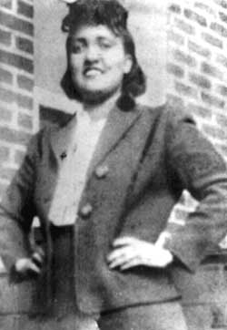
Henrietta Lacks
Henrietta Lacks (August 1, 1920 – October 4, 1951 was an African American woman who was the unwitting donor of cells from her cancerous tumor that was biopsied during treatment for cervical cancer at the Johns Hopkins Hospital in Baltimore, Maryland, U.S. These cells were cultured by George Otto Gey to create the first human immortal cell line, now known as the HeLa cell line, which is still used for medical research.

Slide 26
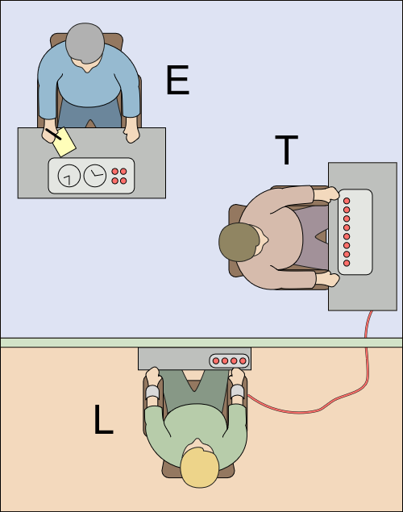
Milgram’s Experiment (1)
The experimenter (E) orders the teacher (T), the subject of the experiment, to give what the latter believes are painful electric shocks to a learner (L), who is actually an actor and confederate. The subject is led to believe that for each wrong answer, the learner was receiving actual electric shocks, though in reality there were no such punishments. Being separated from the subject, the confederate set up a tape recorder integrated with the electro-shock generator, which played pre-recorded sounds for each shock level.

Slide 27
Milgram’s Experiment (2)
The Milgram experiment on obedience to authority figures was a series of social psychology experiments conducted by Yale University psychologist Stanley Milgram. They measured the willingness of study participants, men from a diverse range of occupations with varying levels of education, to obey an authority figure who instructed them to perform acts conflicting with their personal conscience; the experiment found, unexpectedly, that a very high proportion of people were prepared to obey, albeit unwillingly, even if apparently causing serious injury and distress. Milgram first described his research in 1963 in an article published in the Journal of Abnormal and Social Psychology and later discussed his findings in greater depth in his 1974 book, Obedience to Authority: An Experimental View. The experiments began in July 1961, in the basement of Linsly-Chittenden Hall at Yale University, three months after the start of the trial of German Nazi war criminal Adolf Eichmann in Jerusalem. Milgram devised his psychological study to answer the popular question at that particular time: "Could it be that Eichmann and his million accomplices in the Holocaust were just following orders? Could we call them all accomplices?" The experiments have been repeated many times in the following years with consistent results within differing societies, although not with the same percentages around the globe

Slide 28
Zimbardo’s Experiment
The Stanford Prison Experiment (SPE) was a landmark study of the psychological effects of perceived power. Specifically, the study focused on the power struggle between prisoners and prison guards. The experiment was conducted at Stanford University on August 14–20, 1971, by a team of researchers led by psychology professor Philip Zimbardo using college students. It was funded by the U.S. Office of Naval Research and was of interest to both the U.S. Navy and Marine Corps as an investigation into the causes of conflict between military guards and prisoners. The experiment is a classic study on the psychology of imprisonment and is a topic covered in most introductory psychology textbooks. The participants adapted to their roles well beyond Zimbardo's expectations, as the guards enforced authoritarian measures and ultimately subjected some of the prisoners to psychological torture. Many of the prisoners passively accepted psychological abuse and, at the request of the guards, readily harassed other prisoners who attempted to prevent it. The experiment even affected Zimbardo himself, who, in his role as the superintendent, permitted the abuse to continue. Two of the prisoners quit the experiment early, and the entire experiment was abruptly stopped after only six days, to an extent because of the objections of graduate student Christina Maslach, whom Zimbardo was dating (and later married). Certain portions of the experiment were filmed, and excerpts of footage are publicly available.

Slide 29
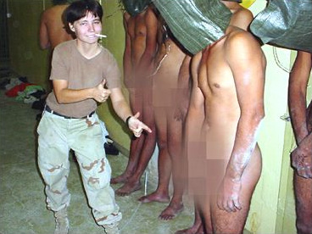
Abu Ghraib

